Slide 1

Optimization in AI
Learn about the importance of optimization in AI, explore different optimization techniques and algorithms, and discover how they are used in real-world applications

Slide 2
Introduction to Optimization
What is Optimization?
Optimization in AI
Benefits of Optimization in AI
Optimization is the process of finding the best solution among a set of possible solutions, subject to a set of constraints. It is used in many fields to maximize or minimize a specific function.
AI relies heavily on optimization techniques to improve accuracy and performance. By optimizing the models used in AI, we can achieve better results with less data and processing.
Optimization can help reduce errors and bias in AI models, improve efficiency and reduce resource usage, and ultimately lead to more accurate and reliable predictions.

Slide 3
Optimization Techniques for Beginners
1
Brute Force Search
A simple approach that involves trying all possible solutions until the best solution is found. It's not efficient for large problems and can become computationally infeasible.
Grid Search
2
A more structured approach that involves evaluating all possible solutions on a grid of predefined values. It's useful when the search space is restricted and the problem is small.
3
Random Search
A heuristic approach that involves randomly sampling solutions from the search space. It's simple to implement and can be effective for some problems, but can be slow or ineffective for others.
Hill Climbing
4
A local search approach that starts from a random solution and iteratively moves to its neighbors, selecting the best neighbor as the next solution. It can get stuck in local optima and may not find the global optimum.

Slide 4
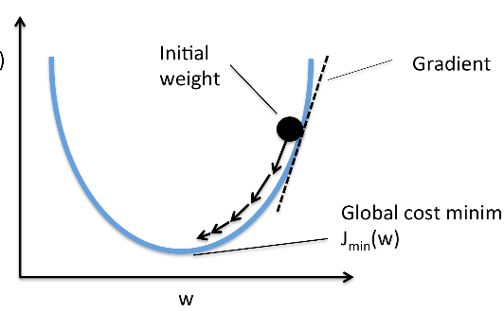
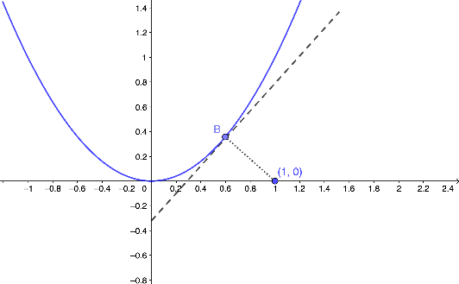
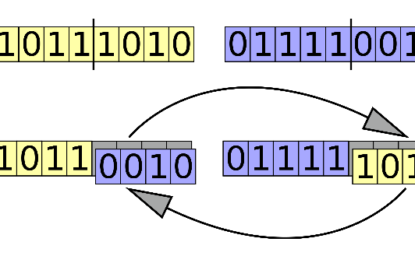
Common Optimization Algorithms in AI
Stochastic Gradient Descent
Newton's Method
Genetic Algorithm
A popular optimization algorithm used in machine learning that iteratively adjusts the model parameters by minimizing the cost function. It uses small random batches of data to speed up the computation.
An iterative optimization algorithm that uses the second derivative of the cost function to find the optimal solution. It can converge faster than other methods but is computationally expensive.
An evolutionary optimization algorithm that simulates the biological process of natural selection. It generates a population of solutions, evaluates their fitness, and selects the best solutions to evolve and reproduce.

Slide 5

Unconstrained Optimization Techniques
1
Gradient Descent
2
Newton's Method
A popular unconstrained optimization technique used to find the minimum of a function by iteratively moving in the direction of the negative gradient. It can converge faster for some problems but may get stuck in local optima.
Another unconstrained optimization technique that uses the second derivative of the function to find the minimum. It can converge faster than gradient descent but may be computationally expensive for large problems.
3
Quasi-Newton Methods
A family of methods that approximate the Hessian matrix (second derivatives) of the function to find the minimum. They can be more efficient than Newton's method for large problems but may not be as accurate.

Slide 6
Constrained Optimization and Linear Programming
Constrained Optimization
Linear Programming
In some cases, the optimization problem requires finding the minimum subject to a set of constraints. This can be done using techniques such as Lagrange multipliers or barrier functions.
A special case of constrained optimization where the objective function and constraints are linear. It's widely used in optimization problems such as resource allocation and production planning.

Slide 7
Evolutionary Algorithms
1
2
3
Introduction
Types of Evolutionary Algorithms
Applications
Evolutionary algorithms are a family of optimization techniques inspired by biological evolution. They work by generating a population of solutions, evaluating their fitness, and selecting the best solutions for reproduction.
Evolutionary algorithms can be used in various optimization problems such as scheduling, resource allocation, and data mining. They are also used in robotics, game development, and artificial life.
Genetic algorithms
Evolution strategies
Genetic programming
Differential evolution

Slide 8
Why is Optimization Important in AI?
Enhancing Performance
Reducing Resource Usage
Real-world Impact
Optimization techniques can help improve the performance and accuracy of AI models, allowing them to generalize better and make better predictions.
By optimizing the models, we can reduce the amount of data and processing power needed, making AI more accessible and cost-effective.
AI optimization is used in various industries such as finance, healthcare, and transportation to solve complex problems and make data-driven decisions.

Slide 9



Real-world Examples of AI Optimization
Self-driving Cars
Healthcare
Finance
Optimization techniques are used to train self-driving cars to recognize and respond to different traffic conditions, obstacles, and pedestrians.
AI optimization is used to analyze medical data and identify patterns that can help diagnose diseases, plan treatments, and improve patient outcomes.
Optimization techniques are used to optimize investment portfolios, perform risk analysis, and forecast market trends in the financial industry.

Slide 10

Conclusion and Resources for Further Learning
1
Conclusion
Optimization is a critical part of AI that helps improve performance, reduce resource usage, and solve complex problems. By learning different optimization techniques and algorithms, we can develop more effective AI models and applications.
2
Resources
Python for Data Science Handbook - Chapter 5: Machine Learning with Scikit-Learn
Optimization for Machine Learning by Suvrit Sra
Introduction to Evolutionary Computing by A.E. Eiben and J.E. Smith

